Slide 1
ORTHOPEDIC CONFENITAL AND DEVELOPMENTAL CONDITIONS IN CHILDHOOD
BY: DR. KING’ORI
DATE: 9/5/2016

Slide 2
INTRODUCTION
Pediatric conditions are relatively common
In most cases the observed abnormalities are simply variations of normal development and with growth these deformities undergo spontaneous correction
No treatment is therefore required for most cases
On the other hand, in a minority of cases the deformities are due to sinister conditions and treatment may be necessary

Slide 3
DEVELOPMENTAL DYSPLASIA OF THE HIP (DDH
Child is born normally but during development the hip doesn’t develop normally i.e. dysplasia
It can vary:
Some degree of subluxation
Some degree of dislocation
This pediatric hip condition was previously known as congenital dislocation of the hip (CDH)
Recently the name change to DDH as it was recognized that in this condition the hip may exhibit a spectrum of abnormalities, which only in a minority of cases it presents as a dislocated hip at birth
In most cases the hip shows various degrees of dysplasia or subluxation (partial dislocation)
In a small number the hip may actually be normal at birth, but becomes abnormal later in life.
The incidence of this condition is about 2-4 cases per 1000 live births
Females are more frequently affected than males 4:1
It may be bilateral in 25% of the cases

Slide 4
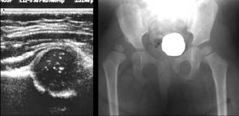
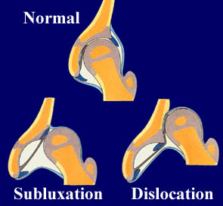

Slide 5
CONT.
If this condition is left untreated, it would lead to serious complications such as severe limp, limb shortening or early onset of OA as an adult
If detected early within the first few days of life, it could easily be treated with a short period of bracing with successful outcome in over 95% of cases.

Slide 6
PROGNOSIS
For this condition is directly related to:
The age of the child
Time of presentation
Severity of the hip dysplasia.

Slide 7
CLUB FOOT (CONGENITAL TALIPES EQUINOVARUS)
Club foot affects 2 per 1000 live births and could be bilateral in 25% of cases. Males are frequently affected than females by 2:1
Deformities in club foot are complex and involves the whole foot, ankle and leg.
In the hind foot, the ankle joint is flexed due to shortening of the Achilles tendon (equinus deformity) and the heel is turned in (varus deformity)
In the forefoot there is a high medial arch (cavus deformity) and the foot has a bean shaped and curled outer border (fore-foot adductus deformity)
The whole leg, foot including calf muscles are smaller on the affected side (equinus deformity – Achilles tendon is shortened hence the plantar is forced to extend)
In 30% of the cases this deformity is flexible and rapidly resolves after birth
In the remaining 70% the deformity is stiff and if left untreated it would lead to severe painful deformities in the long term and the affected child could end up walking on the outer aspect of the foot.

Slide 8
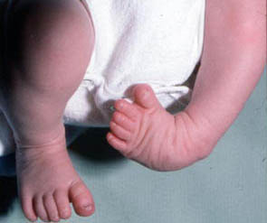

Slide 9
TREATMENT
For flexible club foot, stretching and serial casting under the supervision of a physiotherapist (ponseti method)
Rapid resolution of the deformity is generally expected within weeks and it is unlikely other methods of treatment would be necessary
Surgery is required for the rigid and non-responding club feet.

Slide 10
PROGNOSIS
With appropriate treatment we expect most children (> 95%) with club foot deformity to lead a normal life into adulthood and even take part in strenuous physical activities

Slide 11
DEVELOPMENTAL CONDITIONS PERTHES’ DISEASE
Avascular necrosis of the femoral head of unknown etiology
The interruption of the blood supply to he femoral head results in collapse, fragmentation and progressive deformity of the hip joint
It affects the age groups 4 – 10 years
Males are more frequently affected than females → 4:1; may be bilateral in 25%
A child suffering from this condition usually presents with hip pain or a limp
However, in 30% of cases the pain may initially be referred to the thigh or the knee
This could on occasions result in missed or delayed diagnosis, especially if the hips are not radiographed routinely in a child with knee or thigh pain.

Slide 12
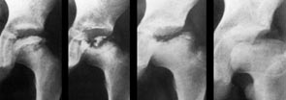

Slide 13
NATURAL HISTORY
In untreated Perthe’s disease, the history is eventual healing and revascularization of the necrotic femoral head within 2-3 years in 75% of the cases. New growth may result in coxa magna
In contrast in 25% of untreated cases this condition results in severe deformity of the hip joint
In these cases operative intervention may be required to improve the outcome
Follow up child closely and do serial X-rays

Slide 14
SLIPPED CAPITAL FEMORAL EPIPHYSIS (SCFE)
This is the commonest cause of hip pain in the adolescent age group (10 – 15 years)
Males are more frequently affected than females (2:1)
May be bilateral in 30% of the cases
Associated factors:
Positive family history
Obesity
Hormonal abnormalities;
Hypo-thyroidism
Hypo-pituitarism
Hypo-gonadism
The pathology is a stress fracture through the upper femoral growth plate resulting in progressive slip of the femoral head over the femoral neck
The affected limp shortens and externally rotates as the deformity increases with time.

Slide 15
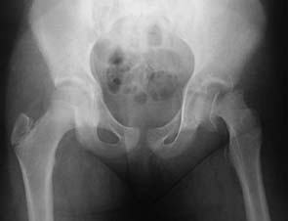

Slide 16
NATURAL HISTORY
If this condition is left untreated it may result in severe limb shortening, fixed external rotation and stiffness of the hip
May then be followed by early onset of OA in adulthood
In most cases the condition presents with a limp and pain in the hip or groin area
However in 30% of the cases, the pain may initially be referred to the knee or the thigh creating diagnostic difficulties.
Treatment of choice:
Insertion of a single cannulated screw per-cutaneously under X-ray control
Prognosis:
Dependent on the severity and the stability of the slip

Slide 17
KNEE DEFOMRITIES: GENU VARUM/VULGUS
Angular deformities of the lower limbs are common in childhood
In most cases this is an entirely benign condition and represent a variation in the normal growth pattern
Presence of symmetrical deformities and absence of symptoms, joint stiffness, systemic disorders or syndromes indicates a benign condition with excellent long-term outcome
In contrast deformities which are asymmetrical and associated with pain, joint stiffness, systemic disorders or syndromes may indicate a serious underlying cause and require treatment.
The most common deformities are:
Bow legs (Genu varum)
Knock nees (Genu valgum)

Slide 18
NATURAL HISTORY
It is important to note that a newborn initially presents with bow legs
With normal growth, knees gradually become straight but the age of 18 months
With further normal development knees gradually drift into valgus (knock knee); in adults, there is a normal 7º valgus (wider in ladies)
This knock knee deformity of maximal at 3-4 years, by 7 years the knee angle (tibio-femoral angle return s to normal adult levels (5º – 7⁰)
Treatment: for pathological deformities depends on the underlying disorders and the severity of the deformity
Metabolic deformities such as rickets could simply be corrected with medical treatment i.e. calcium and vitamin D supplements

Slide 19
TREATMENT
Not required for the physiological deformities i.e. deformities within 2 SD or deformities that are not associated with sinister features such as pain. Asymmetry, systemic disorders or syndromes
For other deformities, depending on the age surgery on form of corrective osteotomy or partial growth plate arrest (epipysiodesis) may be needed.

Slide 20
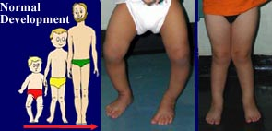

Slide 21

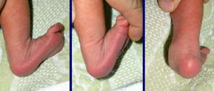
CALCANEO-VULGUS

Slide 22
CONT.
This is the most common paediatric foot deformity.
As the name implies, in this condition the hindfoot is in excessive calcaneus (dorsiflexed) and valgus position.
In a walking child, on weight-bearing the foot has an excessively everted and pronated appearance.
This is an entirely benign condition in majority of cases.
It is usually secondary to joint laxity and immature muscle pattern as seen in the newborn or a young child.
Other than gentle stretching exercises no other treatment is generally required and long-term prognosis is excellent

Slide 23
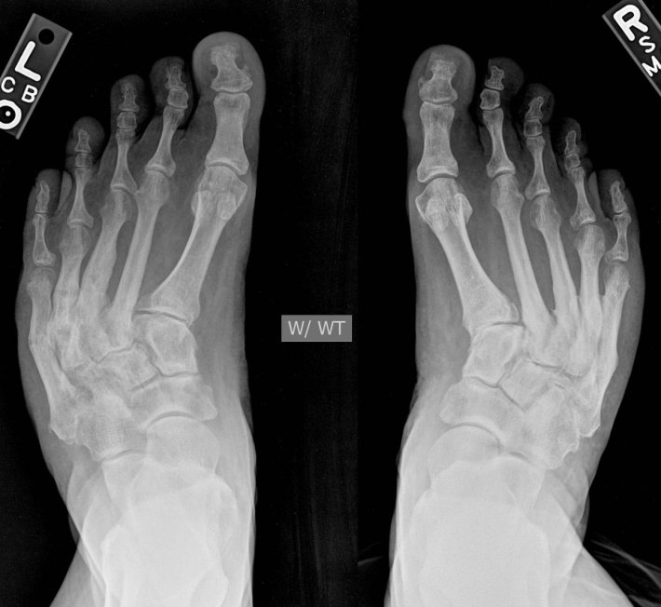
OTHER CONDITIONS
Metatarsus adductus - this is a congenital problem with forefoot adducted and sometimes supinated.
- It is usually treated by manipulation, casting and occasionally surgery.

Slide 24
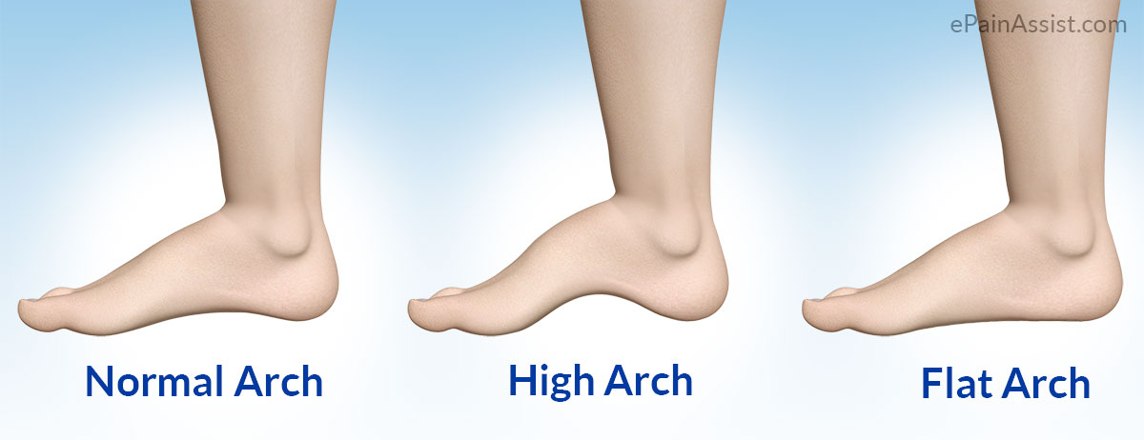
PES CAVUS
this causes a high arch which does not flatten with weight-bearing.
Treatment options include physical therapy, orthotics and surgery, depending on severity.

Slide 25
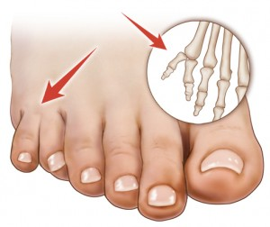
POLYDACTYLY
this is the most common deformity of the foot and can vary from minor degrees of soft tissue duplication to major skeletal abnormalities.
The most common abnormality is an extra fifth toe.
Surgical removal is the usual treatment

Slide 26
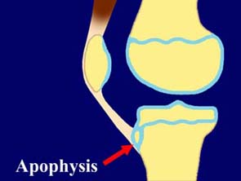
TIBIAL APOPHYSITIS (OSGOOD-SCHLATTER DISEASE)
Inflammation at the insertion of the patellar tendon on the tibial tubercle.
usually requires conservative treatment with activity modification, physical treatment, bracing, orthotics and, rarely, surgical exploration of tibial tubercle.

Slide 27
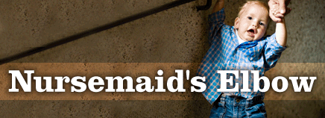
NURSEMAID’S ELBOW
The annular ligament becomes trapped in the radio-humeral joint.
It is also known as subluxation of the radial head.
Simple manipulation can reduce the subluxation but recurrence may require ligament reconstruction.

Slide 28
TYPED BY EFFIE NAILA

